Slide 1
Business Forecasting
Using Leading and Lagging Indicators in Forecasting
Group 3

Slide 2
Team Contribution
Name | ID | Contribution
Abdullah Ba Salama | 5588735 | What are Leading and Lagging Indicators
Hsin Lee | 5607615 | SWOT Analysis
Hrishikesh | 5663354 | When to use Leading and Lagging Indicators
Krishnapriya P S | 5622793 | Steps for Forecasting
Samriddhi Khare | 5663618 | Real Life Applications

Slide 3
Contents
Leading & Lagging Indicators
SWOT Analysis
Steps for Forecasting
Real Life Applications

Slide 4
Leading and Lagging Indicators

Slide 5

History & Application of Leading and Lagging Indicators
Origins in Economics (1938):
Developed by economists Wesley C. Mitchell and Arthur F. Burns to predict economic trends^{[1].}
Evolution of Measurement Tools:
Introduction of composite indexes like the Composite Index of Leading Indicators for better forecasting ^{[2].}.
Business & Economic Impact:
Companies and policymakers use these indicators for decision-making and strategy planning.
Essential for economic forecasting, business growth, and market analysis.
^{[1]} (Shaw, E.S., 1947)
^{[2]} (The Conference Board, 2025)

Slide 6
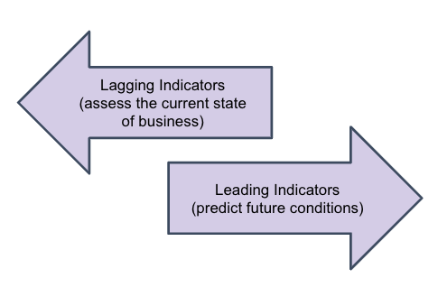
Leading and Lagging Indicators^{[3]}
Leading Indicators: Predict future performance and drive daily initiatives
Help businesses stay on track toward desired outcomes.
Examples: Manufacturing output, stock market trends, housing market data, consumer confidence.
Lagging Indicators: Reflect past performance and shape long-term strategy
Provide an objective view of past success.
Examples: Unemployment rates, revenue metrics, GDP figures.
Why Track Both?
Leading indicators help identify areas for proactive improvement.
Lagging indicators confirm trends and evaluate overall success.
^{[3]} (Xu, 2025)

Slide 7
Leading and Lagging Indicators^{[4]}
Leading Indicators
These change before the economy does, helping us guess where things are headed
Lagging Indicators
These change after the economy has already changed. They confirm what already happened
Lagging indicators confirm trends and help policymakers make better future decisions
Leading indicators are the best for predicting economic changes
^{[4]} (Colin, 2021)

Slide 8

When to use Leading Indicators?^{[5]}
Key Situations
Economic Forecasting – Used by policymakers to anticipate recessions or economic expansions.
Business Strategy & Market Planning – Helps businesses adjust operations before market changes.
Investment and Financial Market Decisions – Guides investors in predicting stock market movements
Employment and Job Market Planning – Forecasts labor demand and workforce needs.
Consumer Behavior and Demand Prediction – Predicts shifts in consumer spending trends.
Companies Using Leading Indicator:
Amazon – Predicts e-commerce demand.
Tesla – Adjusts production based on government EV policies.
Goldman Sachs – Forecasts market trends.
Google – Uses search behavior for digital marketing.
^{[5]} (Watts, 2024)
Notes:
Used in:
Economic Forecasting – Predict recessions.
Business Strategy – Adjust operations early.
Investment – Guide stock market decisions.
Job Market – Forecast labor demand.
Consumer Behavior – Predict demand shifts.
Companies: Amazon, Tesla, Goldman Sachs, Google.

Slide 9
When to use Lagging Indicators?^{[6]}
Key Situations
Economic Performance Evaluation – Confirms whether a recession or economic expansion has occurred.
Business Performance Assessment – Measures past sales, revenue, and profitability trends.
Unemployment and Labor Market Analysis – Assesses the effectiveness of past job creation programs.
Inflation and Cost of Living Assessment – Used by central banks to adjust monetary policies.
Financial Stability and Interest Rate Adjustments – Evaluates the impact of past monetary policies.
^{[6]} (Kenton, 2024)
Notes:
Economic Evaluation – Confirm recessions.
Business Performance – Analyze past sales.
Labor Market – Assess job trends.
Inflation – Guide central bank policies.
Financial Stability – Evaluate interest rates.

Slide 10
When to use Lagging Indicators?^{[7]}
Companies & Institutes
Federal Reserve – Adjusts interest rates based on past inflation.
Coca-Cola – Analyzes quarterly revenue for business decisions.
World Bank & IMF – Monitor GDP growth for policy adjustments.
Ford & Tesla – Use past vehicle sales to refine future strategies.
^{[7]} (Rohn, 2024)
Notes:
Federal Reserve – Interest rates.
World Bank & IMF – GDP growth.
Coca-Cola – Revenue trends.
Ford & Tesla – Past sales for planning.

Slide 11
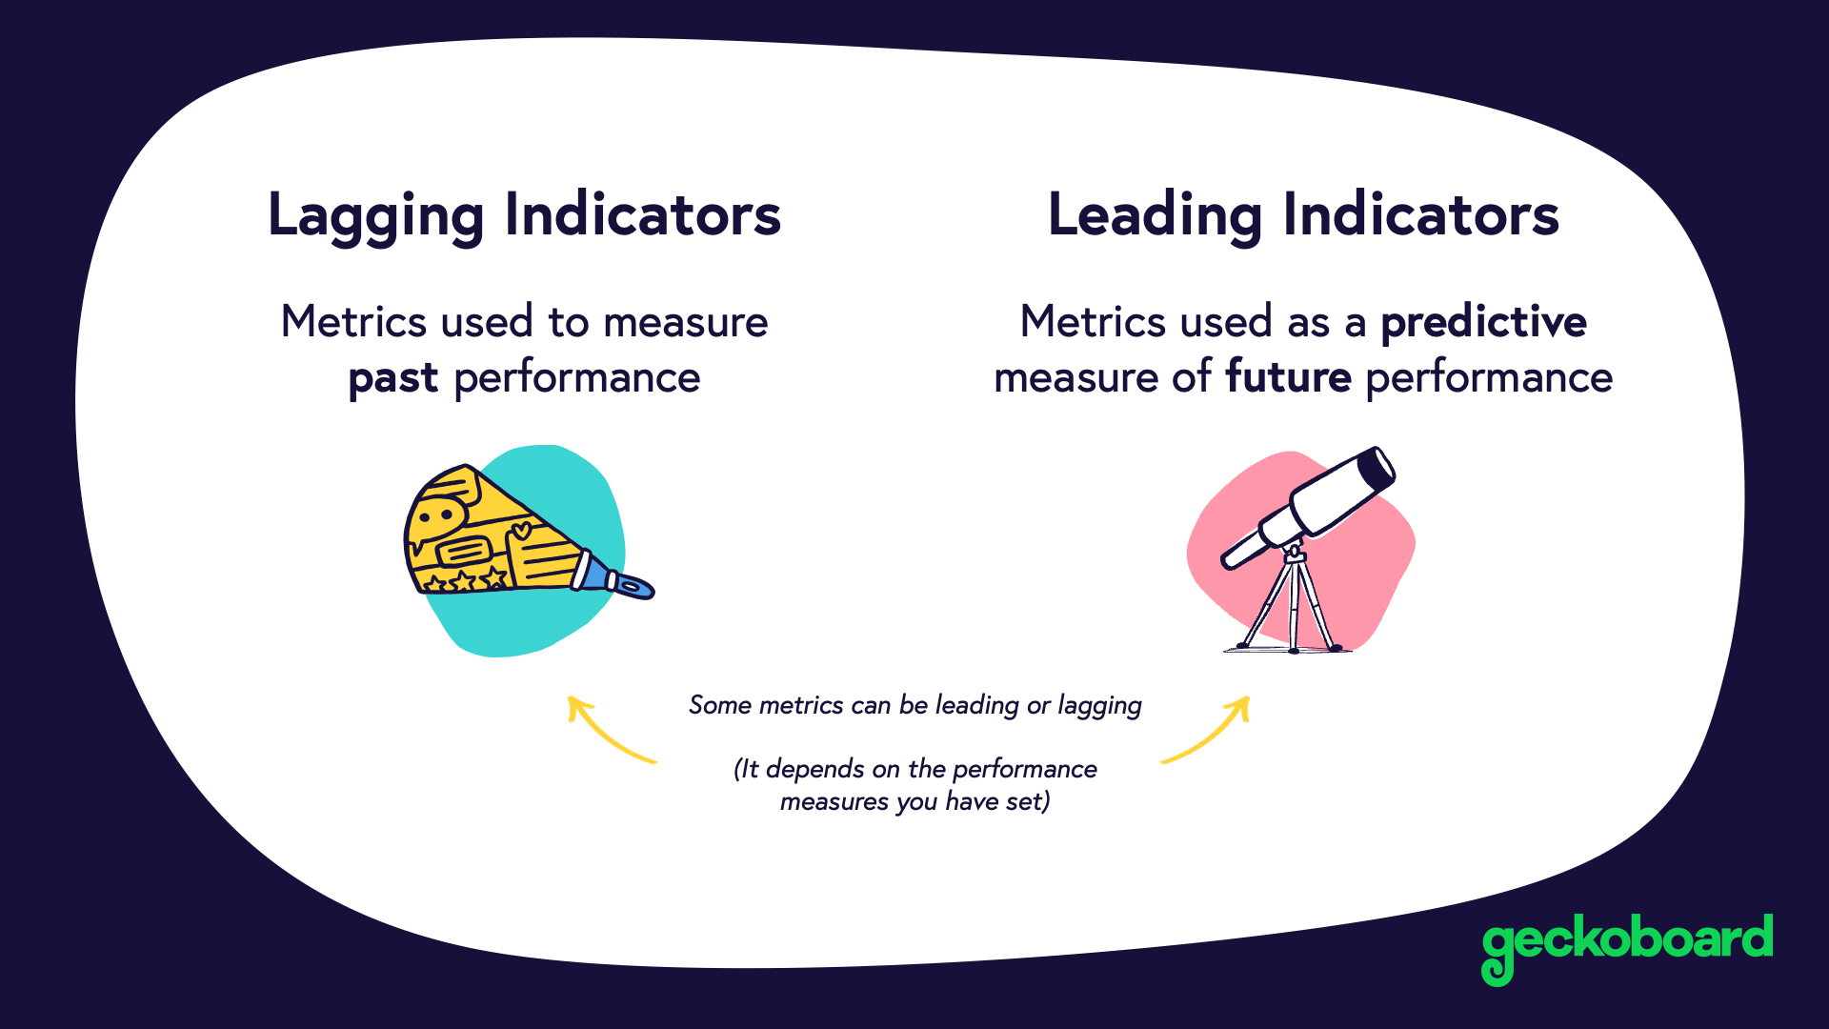
Comparing Leading vs Lagging Indicators^{[8]}
Feature | Leading Indicators | Lagging Indicators
Purpose | Predicts future trends | Confirms past trends
Timing | Before the event occurs | After the event has occurred
Examples | Stock Market, Consumer Sentiment, Housing Permits | GDP, Unemployment Rate, Inflation
Use Cases | Risk management, early warnings, investment decisions | Economic assessment, policy evaluation
Reliability | Less reliable, may give false signals | Highly reliable, based on real data
Decision-Making | Proactive | Reactive
^{[8]} (Geckoboard, 2021)
Notes:
Leading indicators = Predictive, proactive (e.g., stock market).
Lagging indicators = Reliable, reactive (e.g., unemployment).
Takeaway: Both are essential for strategic decision-making.

Slide 12
SWOT Analysis

Slide 13

SWOT Analysis – Leading Indicators^{[3,9]}
STRENGTHS
WEAKNESSES
✅ Predictive Power
✅ Proactive Decision-Making
✅ Useful for Policy & Strategy
✅ Helps Investors & Businesses
False Signals ❌
Short-Term Volatility ❌
Doesn’t Guarantee Accuracy ❌
Varies by Industry & Economy ❌
S
W
O
T
OPPORTUNITIES
THREATS
🔹 Technology & AI Improvements
🔹 Globalization & Market Insights
🔹 Better Business Adaptability
🔹 Integration with Lagging Indicators
Unexpected Economic Shocks ⚠️
Policy & Government Interventions ⚠️
Data Manipulation Risks ⚠️
Speculative Market Reactions ⚠️
^{[9]}(Hanke & Wichern, 2015)
^{[3]} (Xu, 2025)

Slide 14
SWOT Analysis – Lagging Indicators^{[3,9]}
STRENGTHS
WEAKNESSES
✅ Reliability
✅ Long-term strategy planning
✅ Low short-term volatility impact
✅ Helps performance evaluation
Unable to predict future trends ❌
Ineffective for real time response❌
S
W
O
T
OPPORTUNITIES
THREATS
🔹 Evaluating economic polices
🔹 Risk Management
🔹 Integration with Leading Indicators
Too slow for decision making⚠️
Missed opportunities ⚠️
May lead to poor investment ⚠️
^{[9]}(Hanke & Wichern, 2015)
^{[3]} (Xu, 2025)

Slide 15
Steps for Forecasting

Slide 16
Steps for Forecasting Using Leading and Lagging Indicators
Step 1
Step 2
Step 3
Step 4
Step 5
Step 6
Define the Problem & Objectives
Collect & Prepare Data
Feature Engineering & Correlation Analysis
Choose the Forecasting Model
Validation & Evaluation
Deployment & Monitoring

Slide 17
Steps for Forecasting Using Leading and Lagging Indicators^{[10]}
Step 1: Define the Problem & Objectives
Identify the target variable to be forecasted
Determine the forecasting horizon
Choose the relevant leading indicators (such as the yield curve spread or new building permits) and lagging indicators (like the unemployment rate or interest rates)
Step 2: Collect & Prepare Data
Data Collection - Source data from trusted repositories (e.g., FRED, World Bank, OECD).
Data preprocessing - Address missing data, ensure stationarity
Step 3: Feature Engineering & Correlation Analysis
Analyse correlation between leading/lagging indicators and the target variable.
Select the most relevant indicators using Granger Causality Test, Principal Component Analysis , ACF & PACF
^{[10]} (Klein and Moore, 1982); (Clements and Hendry, 1998) ; (Merriam, 1971)

Slide 18
Steps for Forecasting Using Leading and Lagging Indicators^{[11]}
Step 4: Choose the Forecasting Model
Model | Data Type | Key Features | Best For | When to Use
VAR/VECM | Multivariate | Captures interdependencies between leading/lagging indicators | Macroeconomic systems | Leading and lagging indicators influence each other
XGBoost | Multivariate | Handles nonlinear relationships, missing data | Complex systems | Many leading indicators with lagged effects
LSTM | Sequential | Learns long-term dependencies in time series | High-frequency data | Leading indicators have delayed, multi-step impacts
Bayesian Structural Time Series | Multivariate | Manages uncertainty, trends, seasonality, & structural breaks | Policy evaluation, structural shifts | To measure the causal effect of changes on outcomes with seasonality and uncertainty.
ARIMAX | Univariate + Exogenous | Extends ARIMA with external leading indicators | Short-term forecasts with 1-2 leading drivers | When the number of leading indicators is small, and simplicity is valued.
Hybrid Models | Multivariate | Combines robustness of stats models with ML flexibility | Volatile environments | Leading indicators are unstable, and relationships shift over time.
^{[11]}(Chambers, Mullick, & Smith, 1971); (Bojer, 2022)

Slide 19
Steps for Forecasting Using Leading and Lagging Indicators^{[12]}
Step 5: Validation & Evaluation
Use RMSE, MAE, and MAPE to evaluate forecast accuracy.
Apply Diebold-Mariano Test to compare different models.
Step 6: Deploy & Monitor
Leading Indicators: Set alerts for thresholds (e.g., yield curve inversion).
Lagging Indicators: Track revisions (e.g., GDP recalculations) and update models
^{[12]} (Diebold, 2012)

Slide 20
Real Life Applications of Leading & Lagging Indicatos

Slide 21
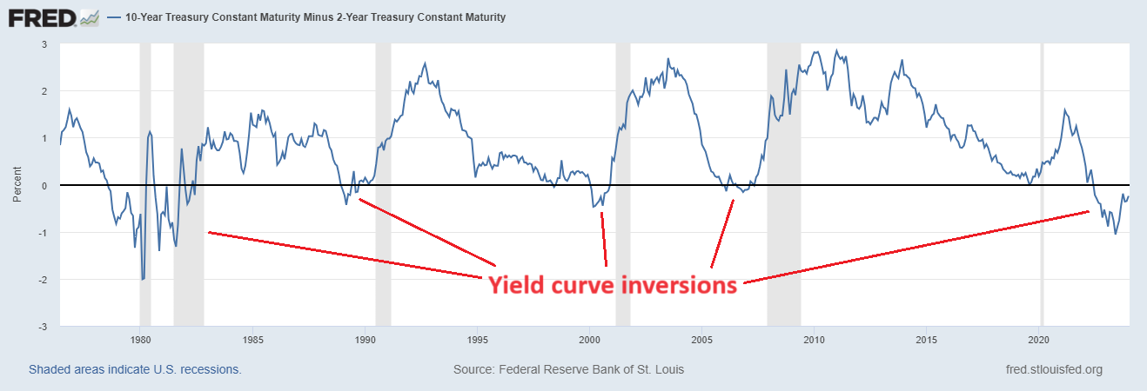
Leading Indicators for Economic Activity^{[13]}
^{[13]} (Fred, 2025)

Slide 22



Yield Curve as a Leading Indicator for Recession^{[14]}
Yield Curve
A key economic indicator that tracks interest rate differences between short-term and long-term bonds.
When it inverts (short-term rates higher than long-term rates), it signals economic trouble ahead.
1
2
3
4
5
1973 – OIL CRISIS RECESSION
1980 & 1981 – DOUBLE-DIP RECESSION
1990 – GULF WAR RECESSION
2000 – DOT-COM BUBBLE BURST
2007 – GLOBAL FINANCIAL CRISIS
Yield Curve Inverted: 1978 & 1980
Recessions Started: 1980 & 1981
Cause: Fed’s aggressive rate hikes to combat inflation.
Yield Curve Inverted: 1989
Recession Started: 1990
Cause: Oil price shock, Fed tightening, and reduced consumer confidence.
Yield Curve Inverted: 2000
Recession Started: 2001
Cause: Tech stock collapse, investment pullback, and corporate accounting scandals.
Yield Curve Inverted: 2006
Recession Started: 2007
Cause: Subprime mortgage collapse, banking failures, and credit market freeze.
Yield Curve Inverted: 1972
Recession Started: 1973
Cause: Oil embargo & stagflation.
^{[14]} (Smith, 2024)
Notes:
Yield as a Leading Indicator:
$$I_{t}=Y_{t−1}+Y_{t}+β(I_{t−1}−i_{t−1})$$

Slide 23
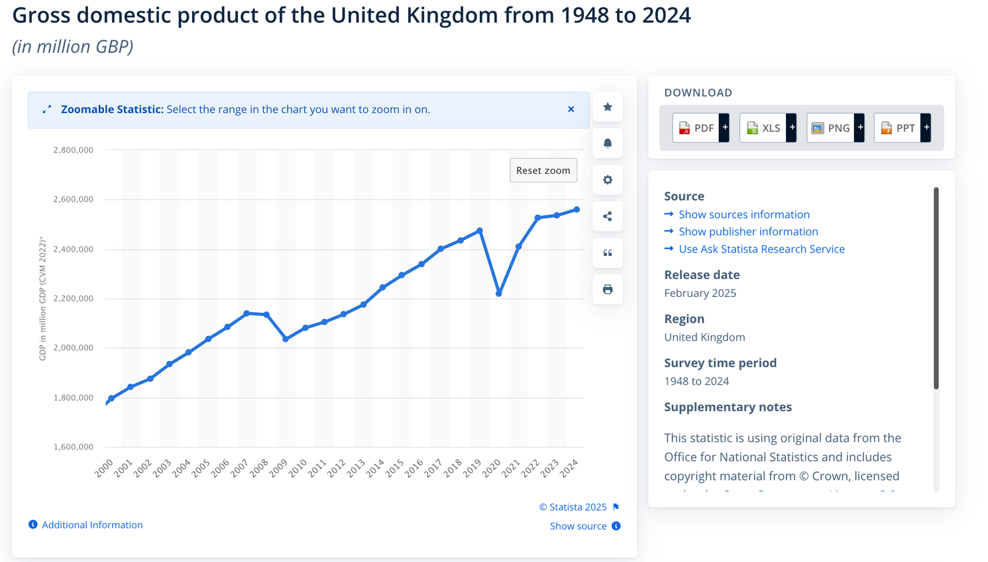
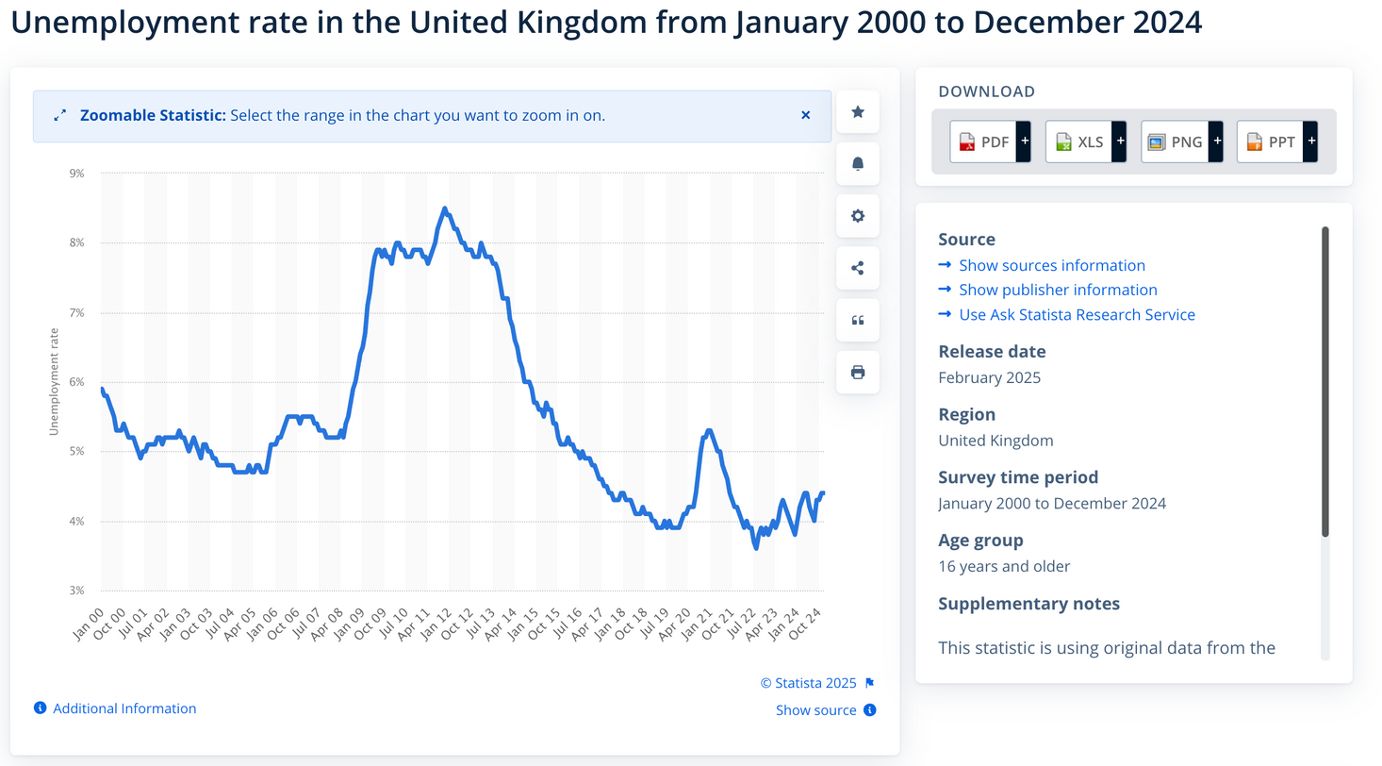
Lagging Indicators for Economic Activity^{[15]}
UNEMPLOYMENT
GDP VS UNEMPLOYMENT
What patterns do you notice between GDP growth and unemployment?
GDP
^{[15]} (Leaker, 2022)

Slide 24
Unemployment as a Lagging Indicator for GDP^{[16]}
2011 – POST-2008 FINANCIAL CRISIS
Unemployment Peak: 2011
Continued to rise even after the recession technically ended in 2008, indicating a delayed recovery in the labor market.
UNEMPLOYMENT
2020 – POST COVID-19
Even as restrictions lifted and the economy rebounded, many people dropped out of the labour force during the pandemic. Some left due to health concerns, others for caregiving responsibilities, and some even opted for early retirement. This made it harder for the labour market to bounce back, leading to a slower recovery in employment rates.
GDP
^{[16]} (OLM, 2025)
Notes:
Unemployment as a Lagging Indicator:
$$U_{t}=U_{t−1}+β(Y_{t−1}−Y)$$

Slide 25
References
[5]20, A. and Watts, S. (2024) Leading vs lagging indicators: What’s the difference?, BMC Blogs. Available at: https://www.bmc.com/blogs/leading-vs-lagging-indicators/ (Accessed: 09 March 2025). ​
[11]Bojer, C. S. (2022). Understanding machine learning-based forecasting methods: A decomposition framework and research opportunities. International Journal of Forecasting, 38(4), 1555-1561. https://doi.org/10.1016/j.ijforecast.2021.11.003​
[11]Chambers, J. C., Mullick, S. K., & Smith, D. D. (1971, July). How to choose the right forecasting technique. Harvard Business Review. Retrieved from https://hbr.org/1971/07/how-to-choose-the-right-forecasting-technique​
[10]Clements, M. and Hendry, D. (1998) ‘Forecasting economic time series’, Cambridge University Press [Preprint]. doi:10.1017/cbo9780511599286. ​
[4]Collin, V. (2021) Leading, lagging & coincident economic indicators, Financial Edge. Available at: https://www.fe.training/free-resources/financial-markets/leading-lagging-coincident-economic-indicators/ (Accessed: 09 March 2025). ​
[2]Conference Board (2025) US leading indicators, The Conference Board. Available at: https://www.conference-board.org/topics/us-leading-indicators (Accessed: 09 March 2025). ​

Slide 26
References
[12]Diebold, F.X. (2015) ‘Comparing predictive accuracy, twenty years later: A personal perspective on the use and abuse of Diebold–Mariano tests’, Journal of Business &amp; Economic Statistics, 33(1). doi:10.1080/07350015.2014.983236.
[13]FRED, T. (2025) 10-year Treasury constant maturity minus 2-year Treasury constant maturity, FRED. Available at: https://fred.stlouisfed.org/series/T10Y2Y (Accessed: 09 March 2025).
[8]Geckoboard, T. (2021) Leading vs lagging indicators: Metrics and Kpis, Geckoboard blog. Available at: https://www.geckoboard.com/blog/leading-lagging-or-lost-how-to-find-the-right-key-performance-indicators-for-your-sales-team/ (Accessed: 09 March 2025).
[9]Hanke, J.E. and Wichern, D.W. (2015) in 180 Day Subscription: Business Forecasting. 9th edn. Pearson Educated Limited, pp. 138–139. Available at: 0133796086, 9780133796087 (Accessed: 09 March 2025).
[6]Kenton, W. (2024) Financial performance: Definition, how it works, and example, Investopedia. Available at: https://www.investopedia.com/terms/f/financialperformance.asp (Accessed: 09 March 2025).

Slide 27
References
[10]Klein, P.A. and Moore, G.H. (1982) The leading indicator approach to economic forecasting--Retrospect and Prospect. Available at: https://papers.ssrn.com/sol3/papers.cfm?abstract_id=226910 (Accessed: 09 March 2025).
[15]Leaker, D. (2022) Labour market overview, UK: September 2022, Labour market overview, UK - Office for National Statistics. Available at: https://www.ons.gov.uk/employmentandlabourmarket/peopleinwork/employmentandemployeetypes/bulletins/uklabourmarket/september2022 (Accessed: 09 March 2025).
[10]Merriam, John H. “Coincident and Lagging Indicators.” Nebraska Journal of Economics and Business, vol. 10, no. 3, 1971, pp. 37–50. JSTOR, http://www.jstor.org/stable/40472393. Accessed 8 Mar. 2025.
[7]Rohn, S. (2024) Leading vs. lagging indicators: 20 examples - whatfix, The Whatfix Blog | Drive Digital Adoption. Available at: https://whatfix.com/blog/leading-vs-lagging-indicators/ (Accessed: 09 March 2025).
[1]Shaw, E.S. (1947) ‘Burns and Mitchell on business cycles’, Journal of Political Economy, 55(4), pp. 281–298.

Slide 28
References
[14] Smith, N. (2024) Does the yield curve tell us a recession is coming soon? Available at: https://www.noahpinion.blog/p/does-the-yield-curve-tell-us-a-recession (Accessed: 09 March 2025).
[16]Team, O.L.M. (2025) Unemployment rate (aged 16 and over, seasonally adjusted): %, Unemployment rate (aged 16 and over, seasonally adjusted): % - Office for National Statistics. Available at: https://www.ons.gov.uk/employmentandlabourmarket/peoplenotinwork/unemployment/timeseries/mgsx/lms (Accessed: 09 March 2025).
[3]Xu, A. (2024) Leading vs. lagging indicators (with real-world examples), Amplitude. Available at: https://amplitude.com/blog/leading-lagging-indicators (Accessed: 09 March 2025).

